Slide 1
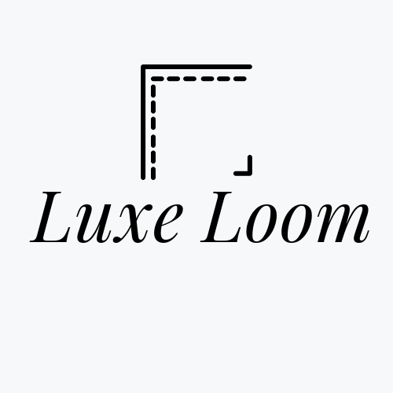
Luxe Loom
Male Fashion E-Commerce

Slide 2

Welcome To The Male Fashion E-Commerce “Luxe Loom”
Panchal Shreyashkumar, Patel Panth & Vasava Sarthakkumar

Slide 3
INDEX
1
2
3
4
5
Introduction
Technical Requirements
Implementati-on
(Screenshot)
Conclusion
References

Slide 4
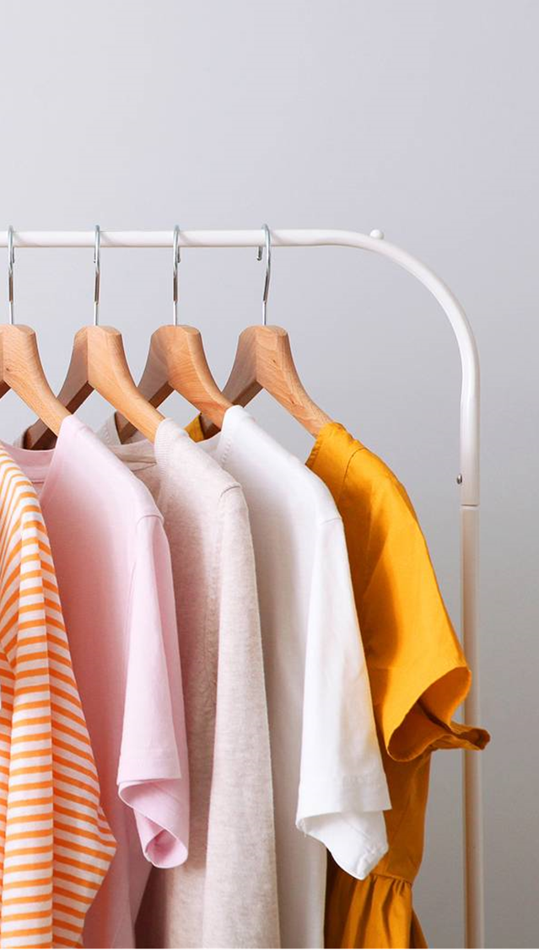
Introduction
Luxe Loom is a refined e-commerce platform tailored for men’s luxury fashion, built using HTML, CSS, JavaScript, and Bootstrap. It offers a sleek, responsive design with a focus on elegance and ease of use. Key pages include a stylish homepage, brand-focused About page, customer-friendly Contact page, and secure Login/Sign Up options. JavaScript enhances interactivity, while Bootstrap ensures smooth navigation across devices. With its clean aesthetics and polished layout, Luxe Loom delivers a premium front-end experience for the modern, fashion-conscious man.

Slide 5
Technical Requirements
Software Components:
HTML5 – For structuring web pages and content.
CSS3 – For styling and visual layout.
JavaScript – For adding interactivity and dynamic behavior.
Bootstrap – For responsive design and pre-built UI components.
Code Editor – Visual Studio Code, Sublime Text, or any preferred IDE.
Web Browser – Google Chrome, Firefox, or any modern browser for testing and viewing..

Slide 6
Software
HTML
JavaScript
Code Editor:-
VS Code
CSS
Bootstrap

Slide 7
Hardware
Development Machine​
Input Devices
Internet Connection
Minimum 4 GB RAM (8 GB or more recommended ​ Duel-core processor or higher
Screen resolution: 1366x 768 or higher for comfortable UI design​
Keyboard and mouse or touchpad
For accessing online resources, libraries (like Bootstrap), and deployment

Slide 8
Operating System: Compatible with any of the following: Windows 10/11

Slide 9
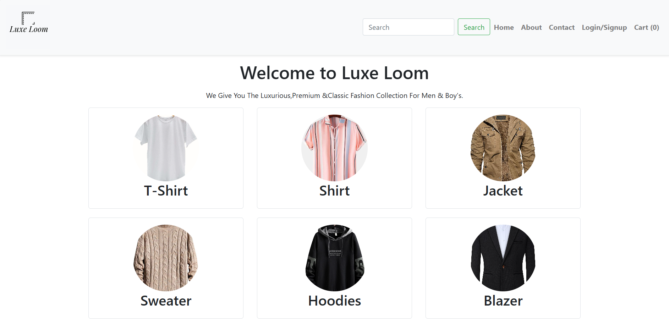
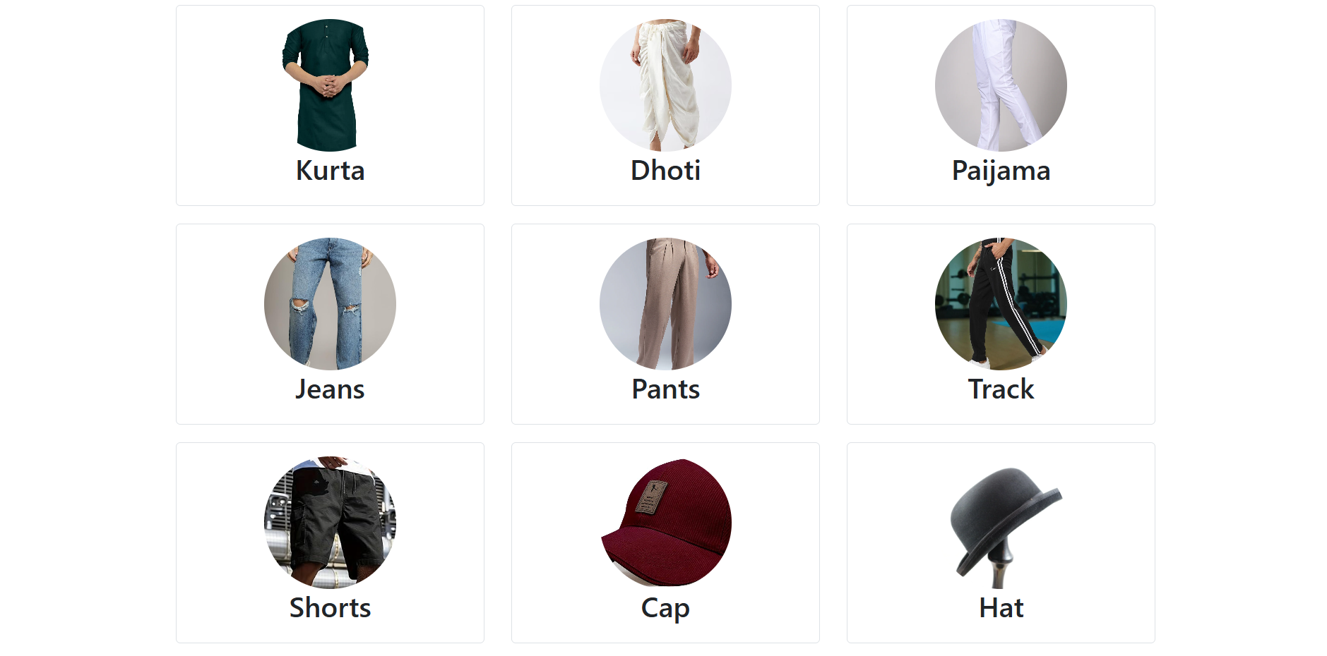
IMPLEMENTATION

Slide 10
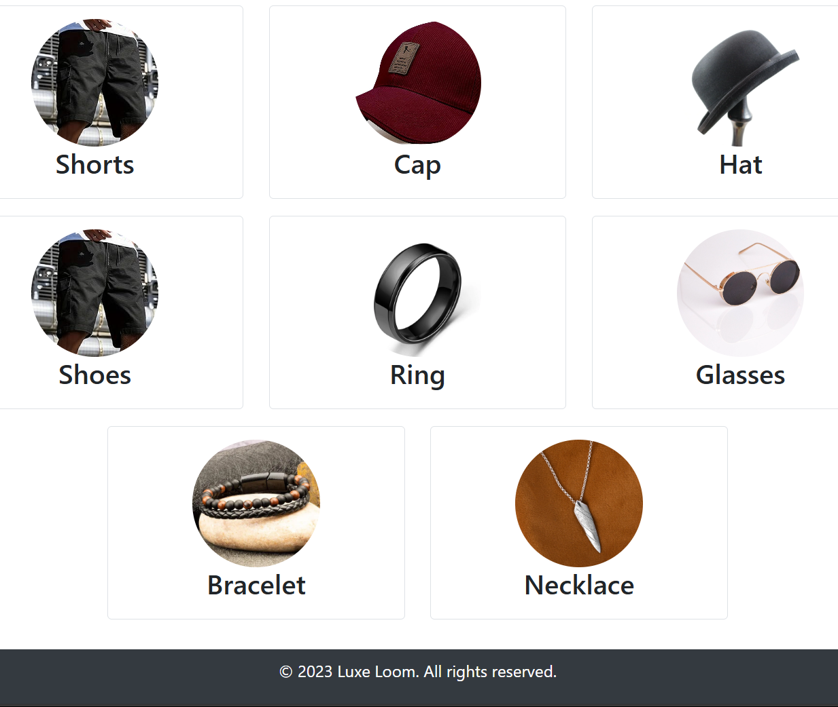
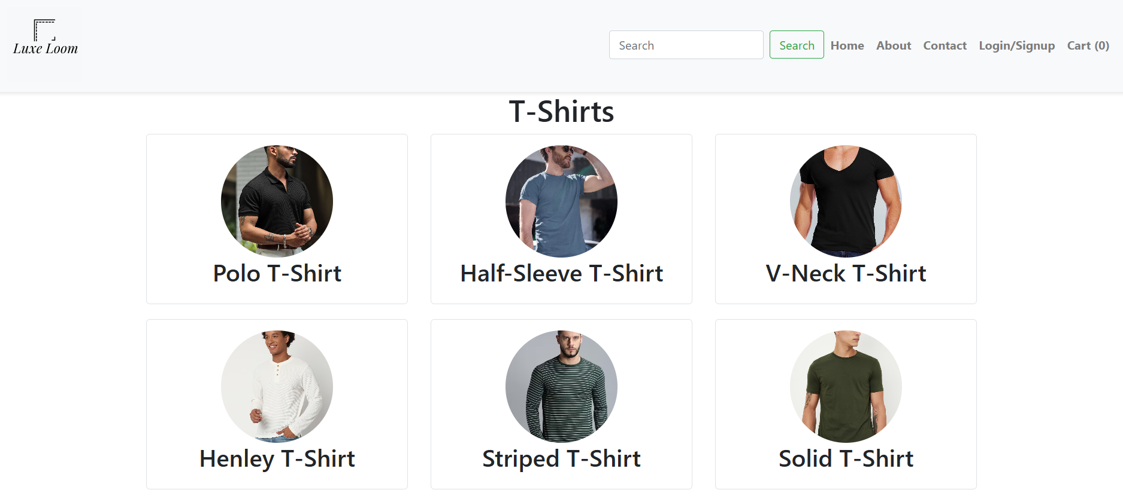
IMPLEMENTATION

Slide 11
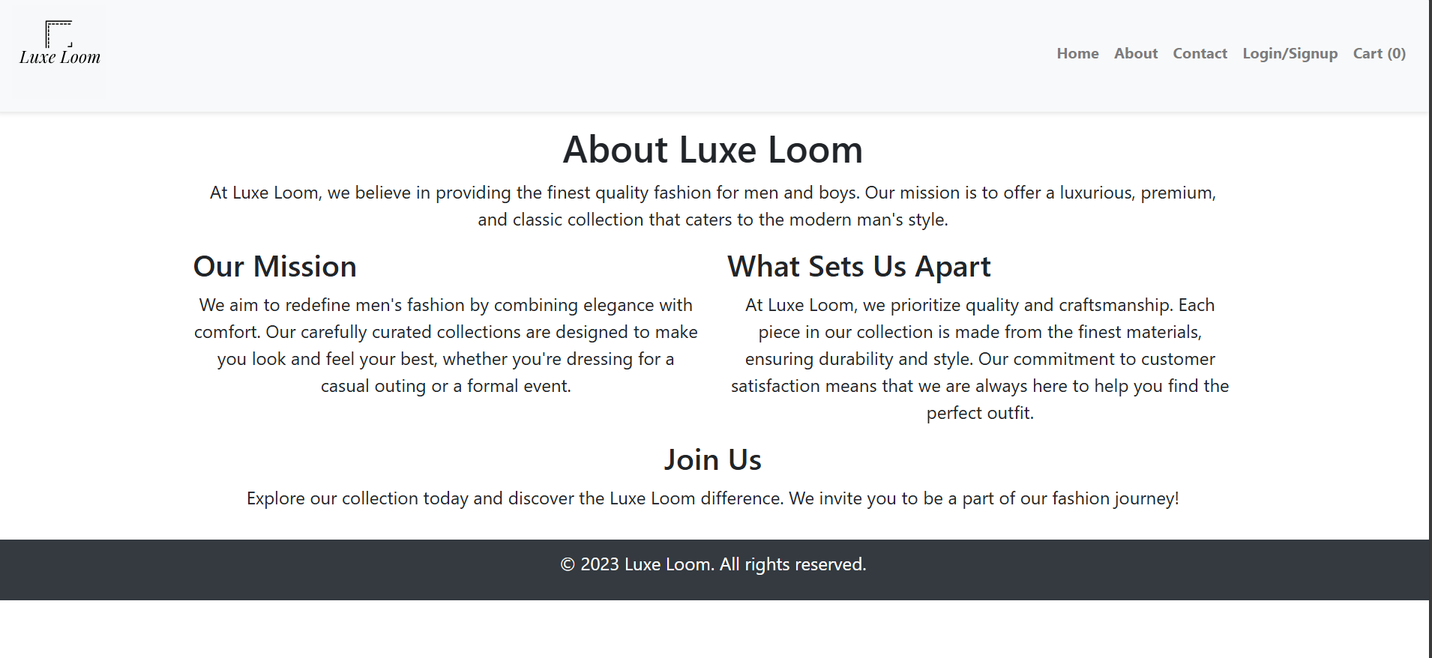
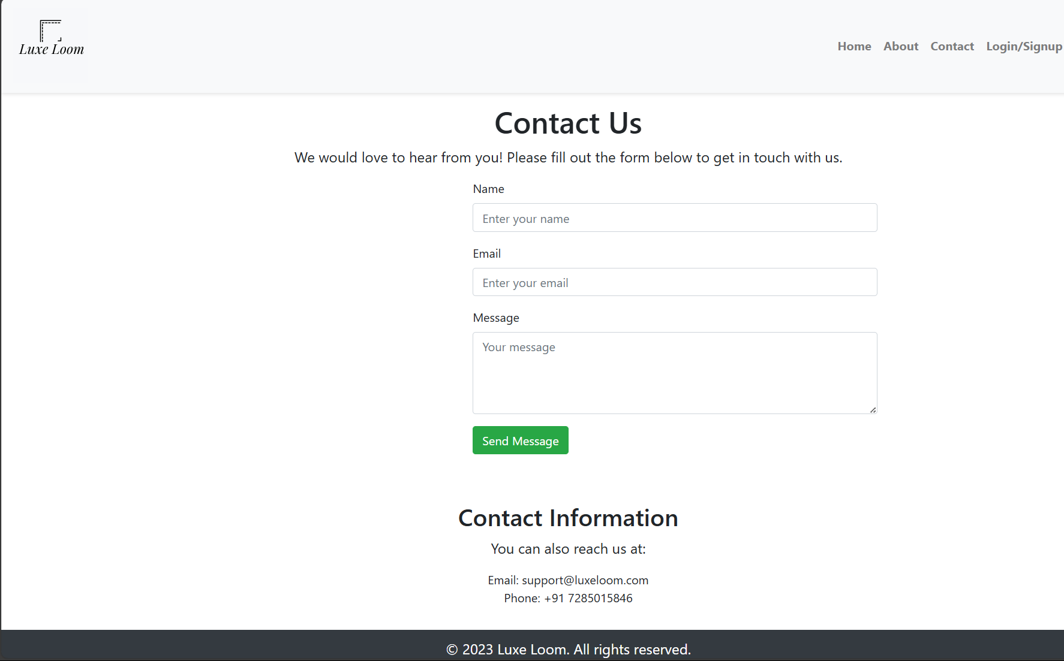
IMPLEMENTATION

Slide 12
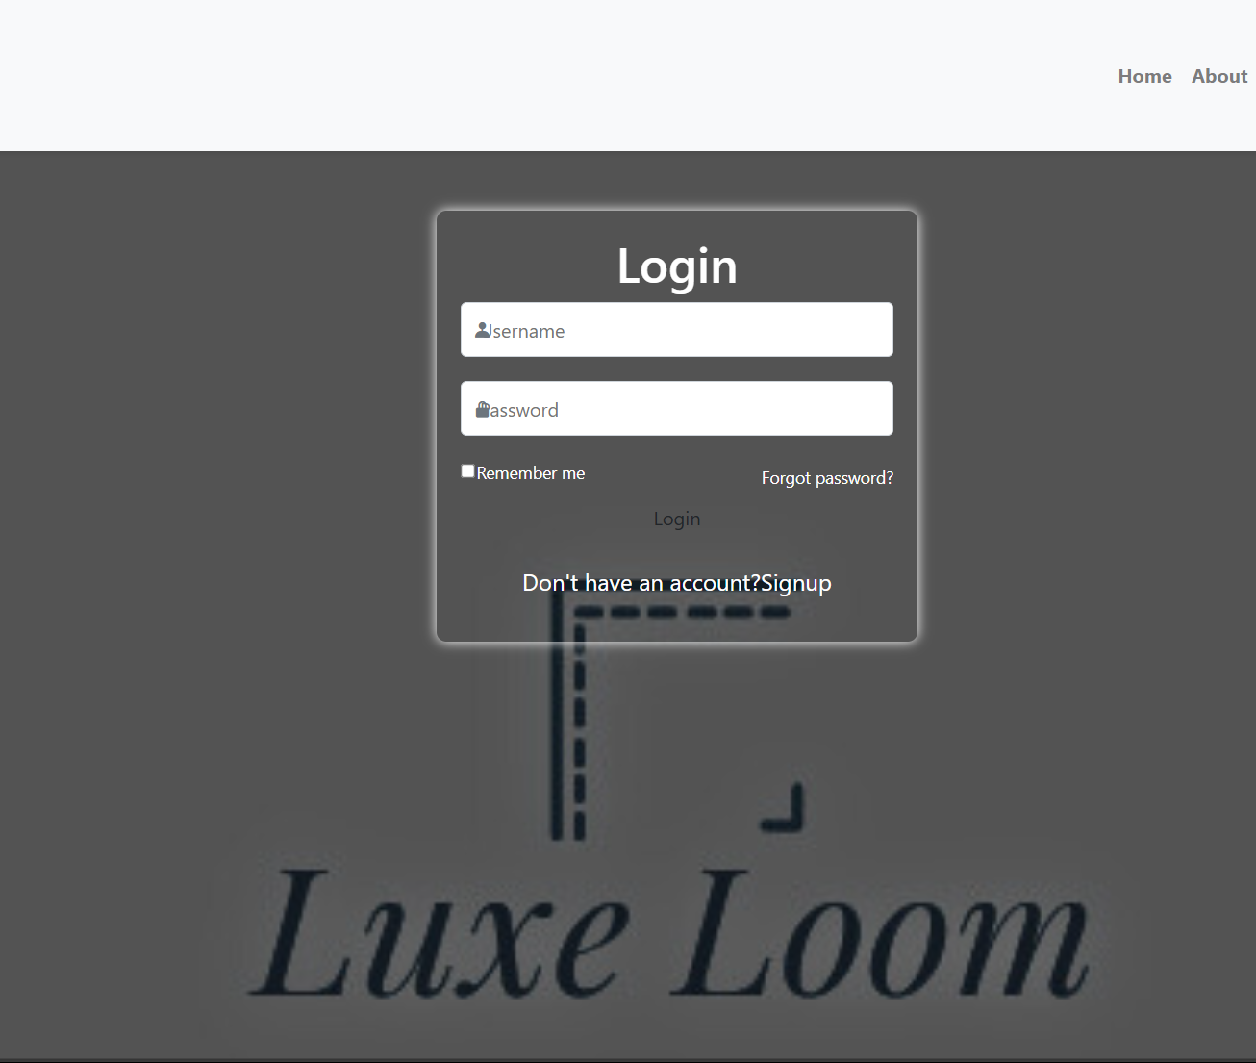
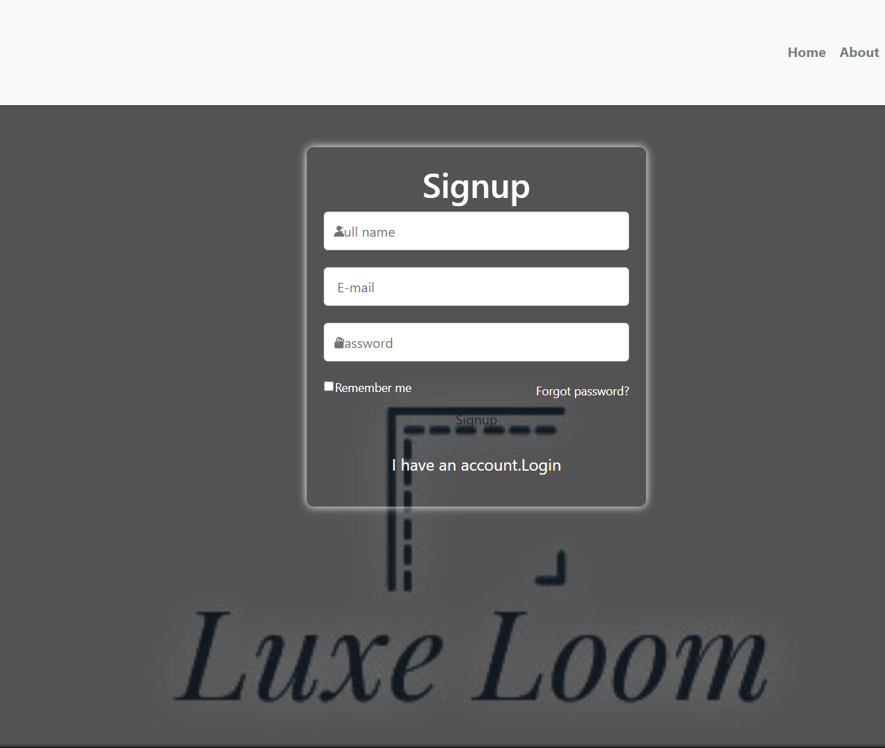
IMPLEMENTATION

Slide 13





Plan for product launch
Planning
Synergize scalable e-commerce
Discussing
Listen opinion of each team member
Design
How Website looks
Testing
How it works
Launch
Ready for presentation

Slide 14
CONCLUSION
​
Luxe Loom is a well-structured front-end e-commerce website dedicated to men's luxury fashion. Developed using HTML, CSS, JavaScript, and Bootstrap, it offers a clean, responsive, and user-friendly interface. The site includes essential pages such as Home, About, Contact, Login, and Signup, allowing users to explore collections, understand the brand, and interact through forms. Although it currently lacks back-end functionality, Luxe Loom provides a solid foundation for further development. With potential enhancements like product detail pages, form validation, and UI improvements, Luxe Loom can evolve into a fully functional and visually appealing fashion platform for modern male consumers.

Slide 15
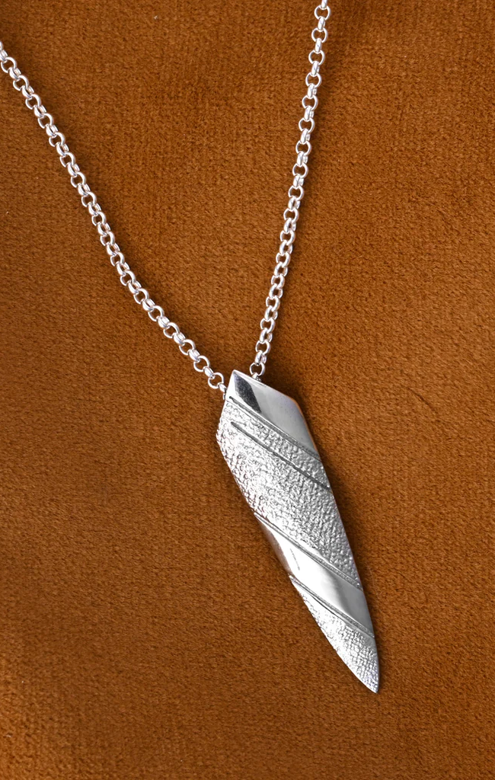
REFERENCES
W3Schools. (n.d.). HTML Tutorial.
Retrieved from https://www.w3schools.com/html/
JavaTpoint. (n.d.). HTML Tutorial.
Retrieved from https://www.javatpoint.com/html-tutorial
W3Schools. (n.d.). CSS Tutorial.
Retrieved from https://www.w3schools.com/css/
JavaTpoint. (n.d.). CSS Tutorial.
Retrieved from https://www.javatpoint.com/css-tutorial
W3Schools. (n.d.). JavaScript Tutorial.
Retrieved from https://www.w3schools.com/js/
JavaTpoint. (n.d.). JavaScript Tutorial.
Retrieved from https://www.javatpoint.com/javascript-tutorial
W3Schools. (n.d.). Bootstrap Tutorial.
Retrieved from https://www.w3schools.com/bootstrap/
Google Images. (n.d.). Various Product and Design Images.
Retrieved from https://images.google.com/
Canva. (n.d.). Logo Design Tool. Retrieved from https://www.canva.com/

Slide 16
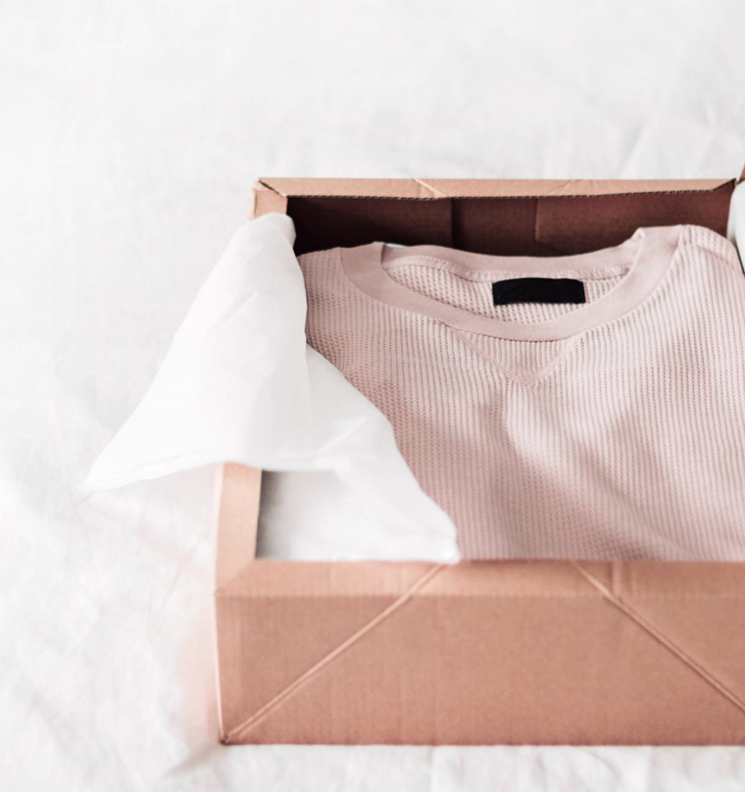
Thank you
Luxe Loom “Team”

